Slide 1
Chapter 2
Network Models

Slide 2
Introduction
In communication and networking, protocol defines the rules that all communicating parties must follow
Communicating parties include
  Sender
  Receiver
  Intermediate devices
Simple communication may need only one simple protocol.
Complex communication needs to divide tasks between different layers.
  So need a protocol at each layer
    Protocol layering

Slide 3
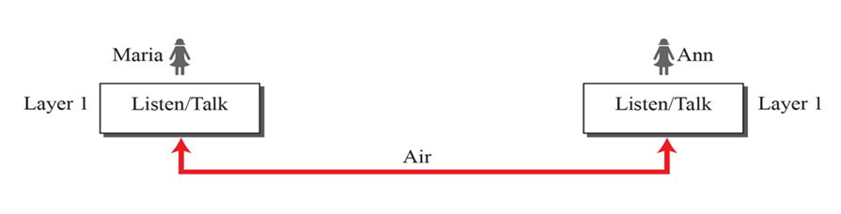
Introduction
A single-layer protocol
Set of rules Maria and Ann would follow:
Greet each other when they meet.
Know that they should confine their vocabulary to the level of their friendship.
Refrain from speaking when the other party is speaking.
Exchange some nice words when they leave.

Slide 4
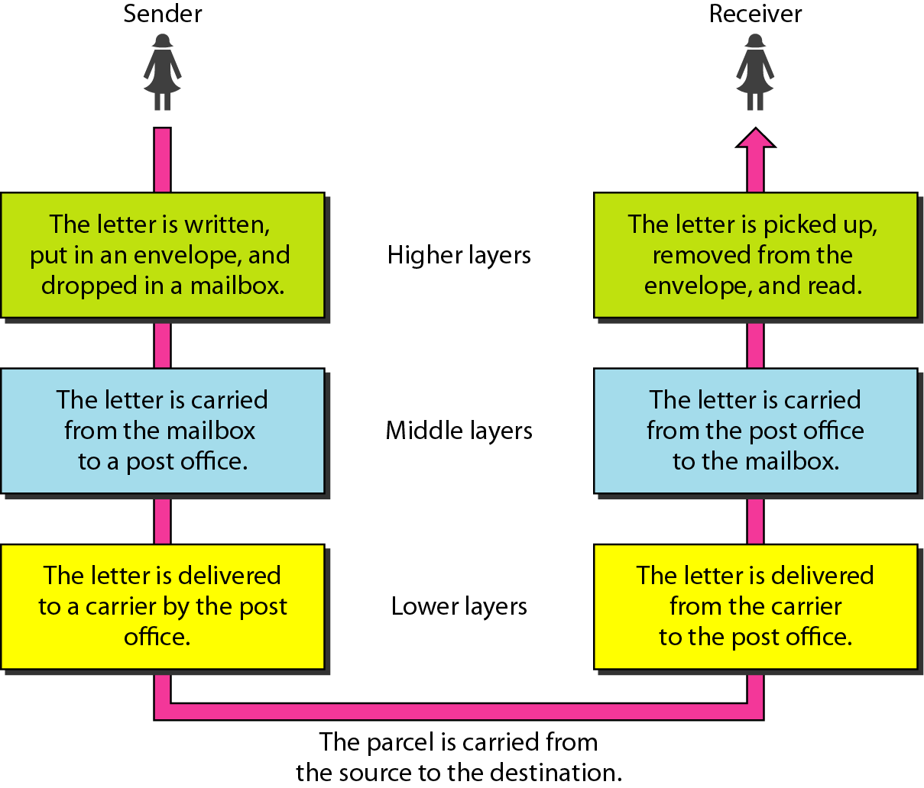
Layered Communication
We use the concept of layers in our daily life.
Let us consider two friends who communicate through postal mail.

Slide 5
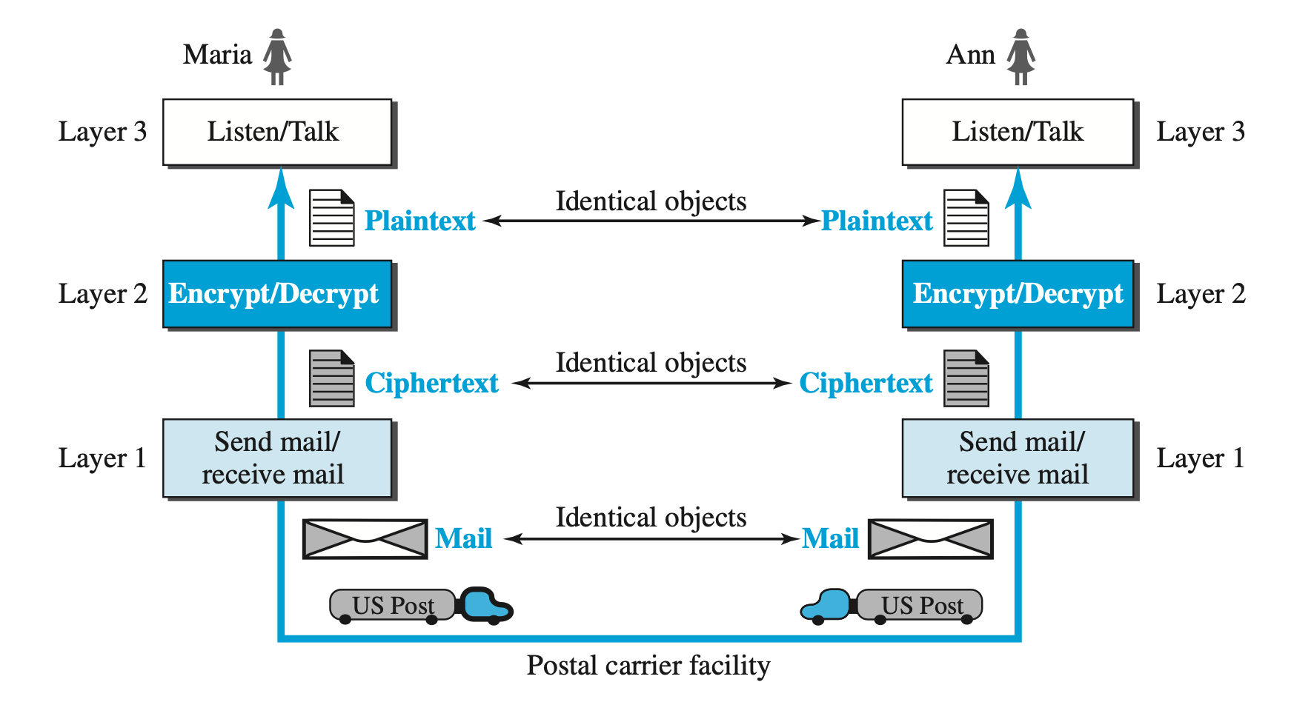
Layered Communication

Slide 6
Protocol Layering
Enables us to divide a complex task into several smaller and simpler tasks.
Modular implementation (Modularity) enables layered replacements.
Layer is black box with inputs and outputs, without concern about how inputs are changed to outputs.
Principles of protocol layering:
  Bidirectional communication needed to make each layer so that it is able to perform two opposite tasks, one in each direction.
  Two objects under each layer at both sites should be identical.

Slide 7
Layered Communication
Each layer at the sending site uses the services of the layer immediately below it.
The sender at the higher layer uses the services of the middle layer.
The middle layer uses the services of the lower layer.
The lower layer uses the services of the carrier.
The layered model that dominated data communications and networking literature before 1990 was the Open Systems Interconnection (OSI) model.

Slide 8
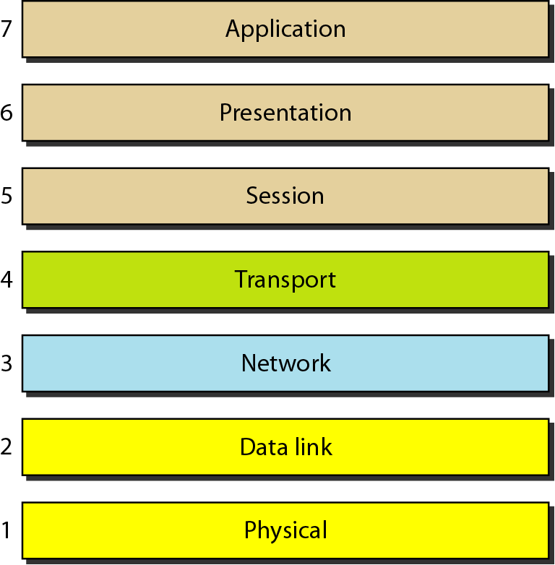
OSI Model
It was first introduced in the late 1970s.
Open system is set of protocols that allow any two different systems to communicate regardless of their underlying architecture.
The OSI model is not a protocol; it is a model for understanding and designing a network architecture that is flexible, robust, and interoperable.
It consists of seven layers, each of which defines a part of the process of moving information across a network.

Slide 9
OSI Model
As the message travels from A to B, it may pass through many intermediate nodes.
Between machines, layer x on one machine communicates with layer x on another machine.
This communication is governed by an agreed-upon series of rules and conventions called protocols.
The processes on each machine that communicate at a given layer are called peer-to-peer processes.

Slide 10
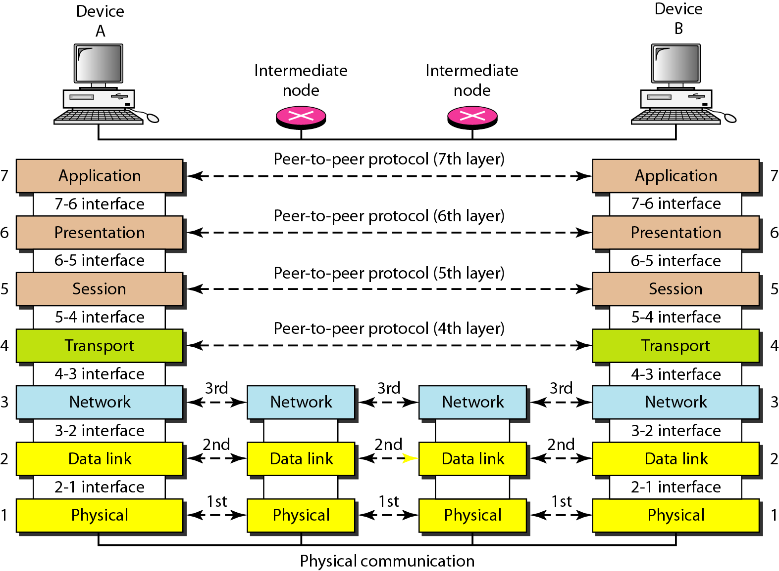
OSI Model
Peer-to-peer process

Slide 11
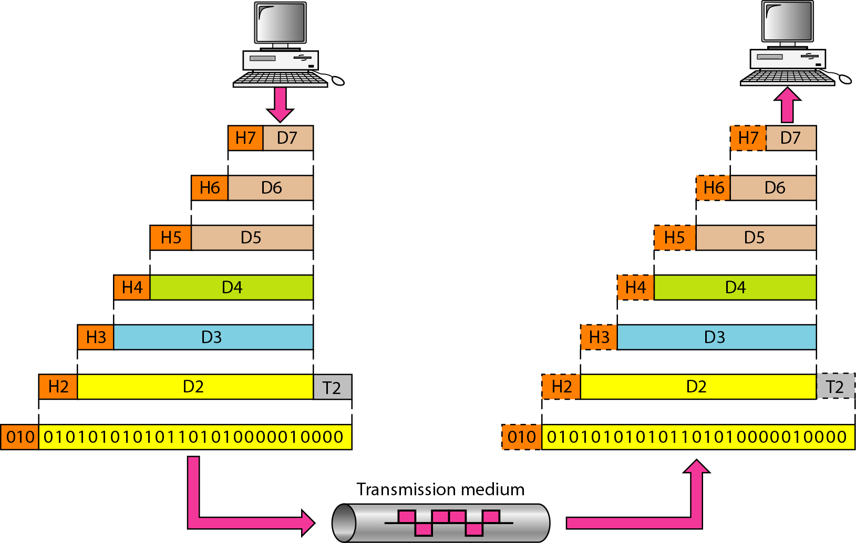
OSI Model
Encapsulation at each layer
Exchange using OSI model

Slide 12
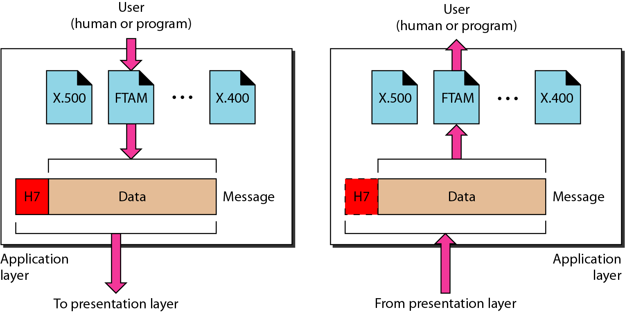
Layers in OSI Model: Application Layer
The application layer enables the user, whether human or software, to access the network.
It provides user interfaces and support for services.

Slide 13
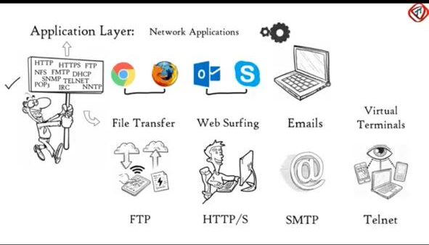

Slide 14
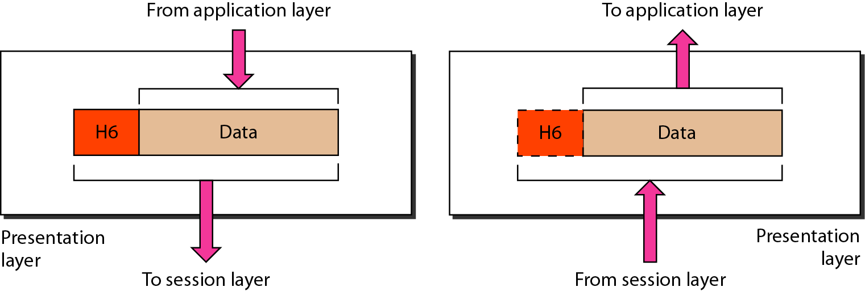
Layers in OSI Model: Presentation Layer
The presentation layer is concerned with the syntax and semantics of the information exchanged between two systems.
The presentation layer is responsible for translation (different coding systems), compression, and encryption.
It converts data formats (EBCDIC ↔ ASCII, UTF‑8 ↔ UTF‑16).
It ensures cross‑platform compatibility.

Slide 15
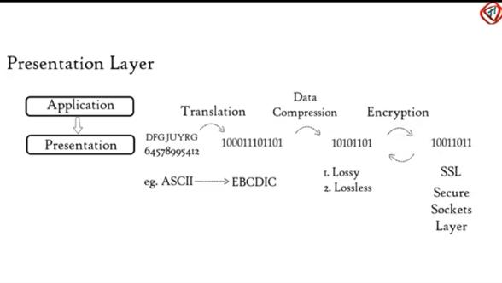

Slide 16
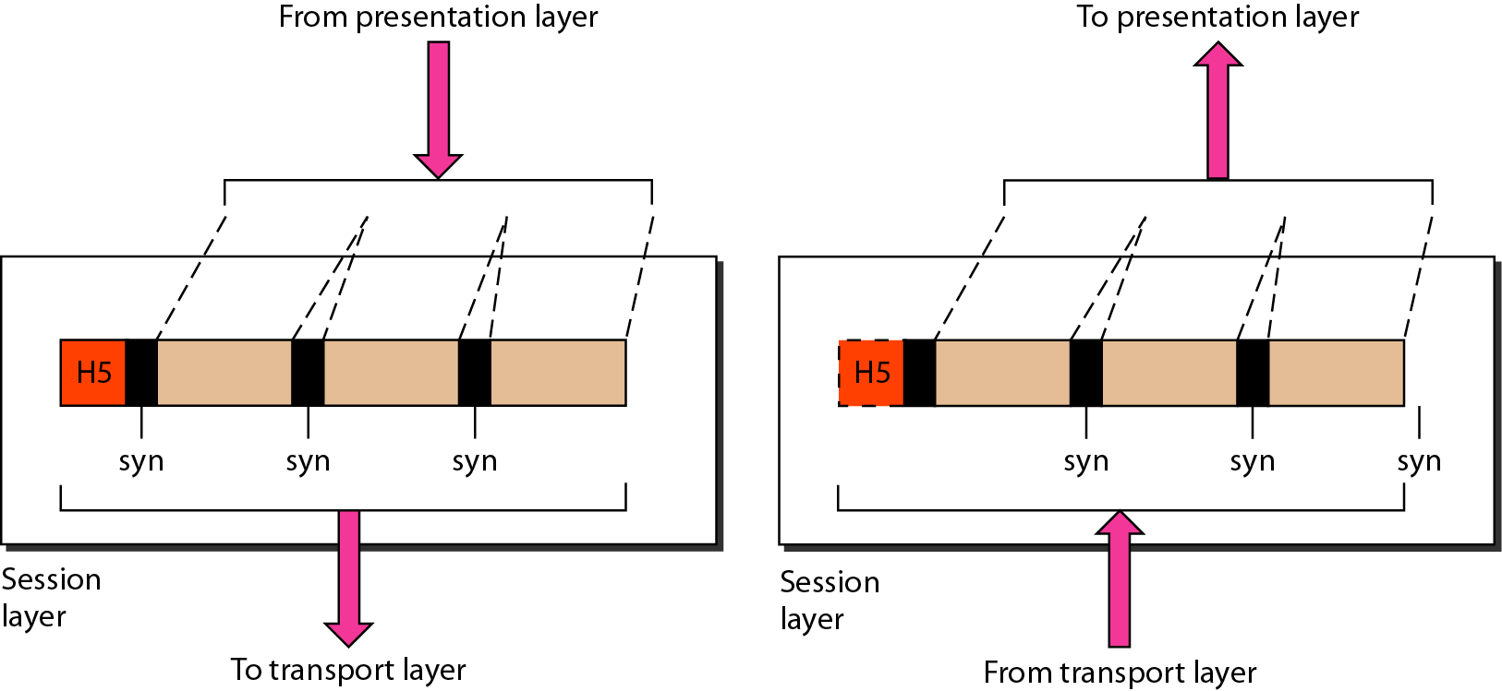
Layers in OSI Model: Session Layer
The services provided by the first three layers (physical, data link, and network) are not sufficient for some processes.
Establishes, manages, and terminates sessions between applications on different devices.
Coordinates dialog control: decides whether communication is half-duplex or full-duplex.
Handles synchronization: inserts checkpoints in long data streams so transmission can resume from a known state if interrupted.
Other responsibilities: authentication, authorization, dialog control and synchronization.

Slide 17
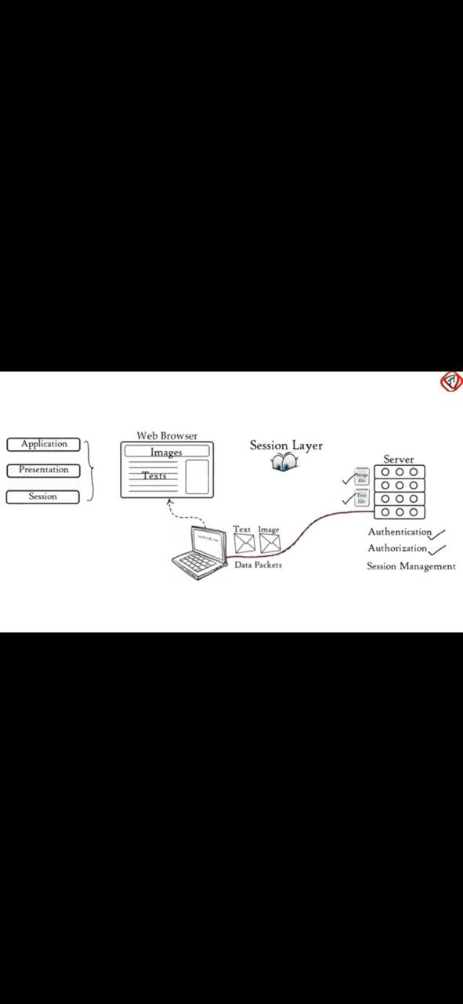
A network session is a temporary and interactive information interchange between two or more devices communicating over a network.

Slide 18
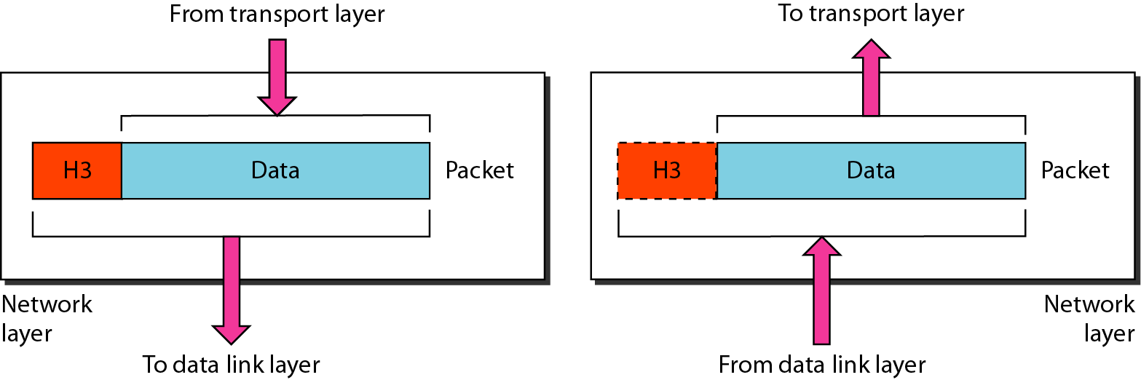
Layers in OSI Model: Transport Layer
The transport layer is responsible for process-to-process delivery of the entire message.
A process is an application program running on a host.
Whereas the network layer oversees source-to-destination delivery of individual packets, it does not recognize any relationship between those packets.
Other responsibilities: service point addressing, segmentation and reassembly, connection management, congestion control, and end-to-end flow control.

Slide 19
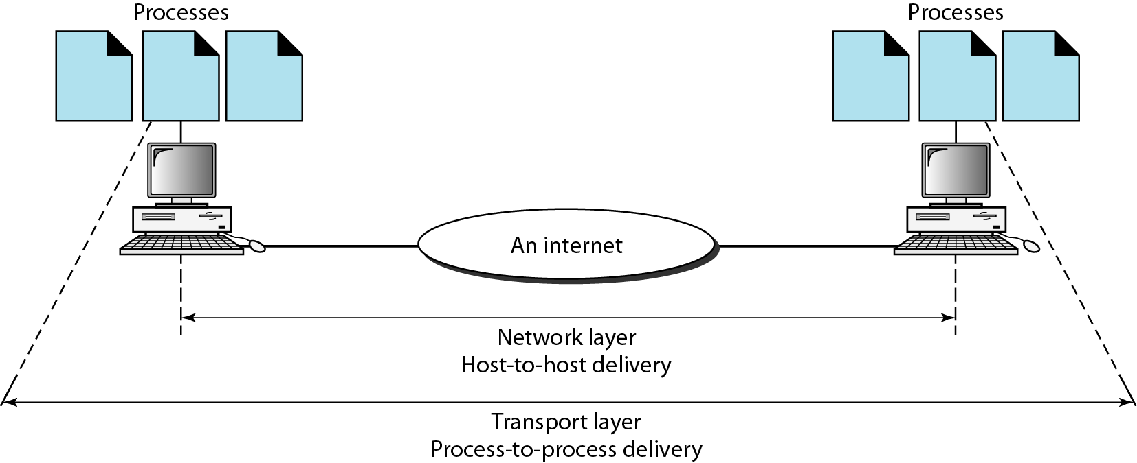
Layers in OSI Model: Transport Layer

Slide 20
Layers in OSI Model: Network Layer
This layer is responsible for the source-to-destination delivery of a packet, possibly across multiple networks (links).
DLL oversees the delivery of the packet between two systems on the same network (links)
If two systems are connected to the same link, there is usually no need for a network layer.
Other responsibilities: logical addressing and routing.

Slide 21
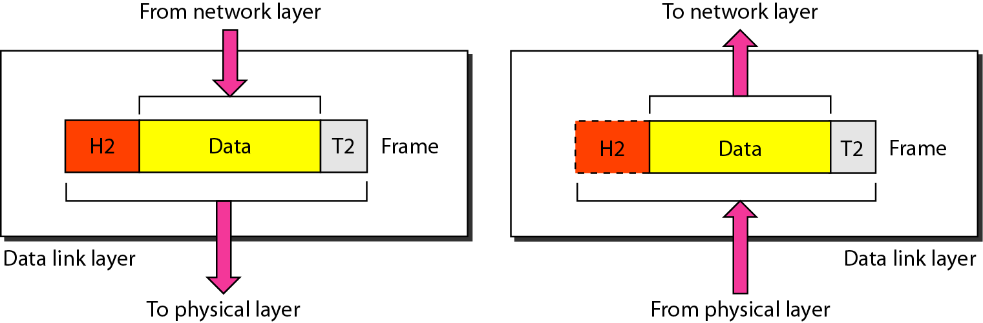
Layers in OSI Model: Data Link Layer
The data link layer is responsible for moving frames from one hop (node) to the next.
This layer transforms the physical layer, a raw transmission facility, to a reliable link.
It makes the physical layer appear error-free to the upper layer (network layer).
Other responsibilities: framing, physical addressing, flow control, error control, and medium access control (prevent data collision), Hop-to-hop delivery

Slide 22
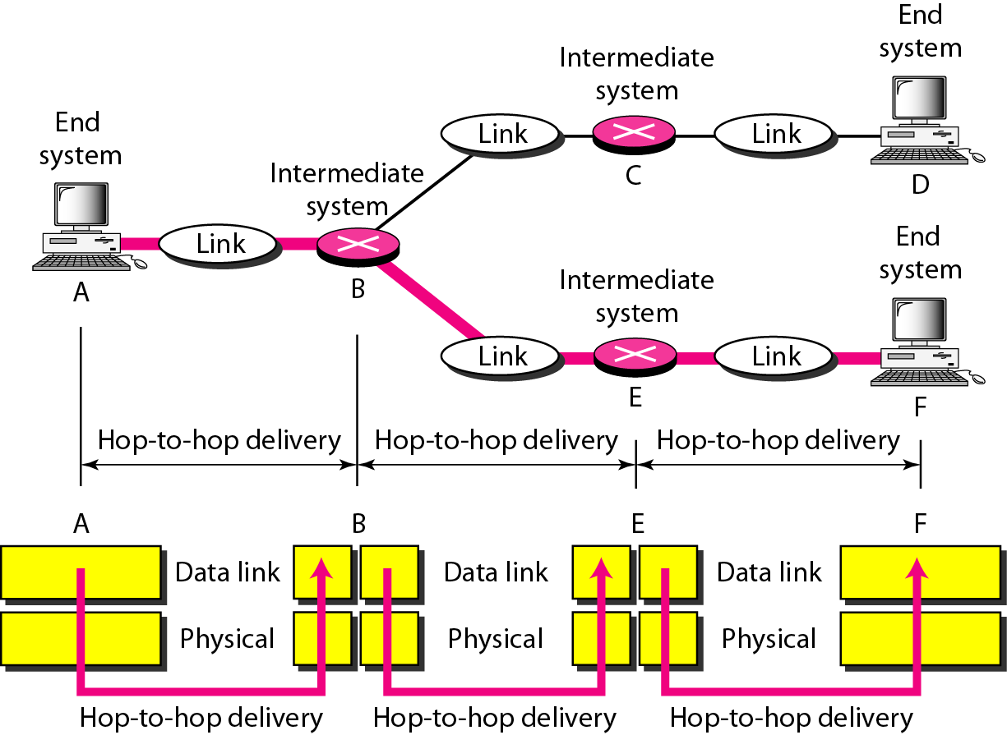
Layers in OSI Model: Data Link Layer

Slide 23
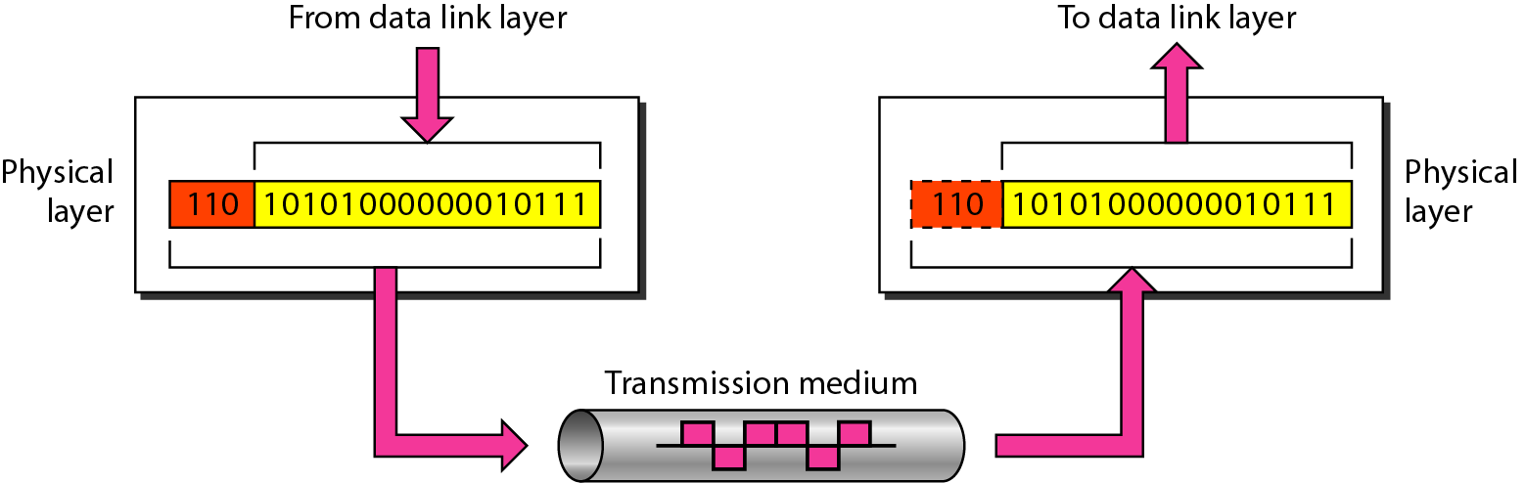
Layers in OSI Model: Physical Layer
This layer is responsible for the movement of bits from one hop (node) to the next.
It deals with the mechanical and electrical specifications of the interface and transmission medium.
It is also concerned with the data rate, synchronization of bits, line configuration, physical topology, and transmission mode.

Slide 24
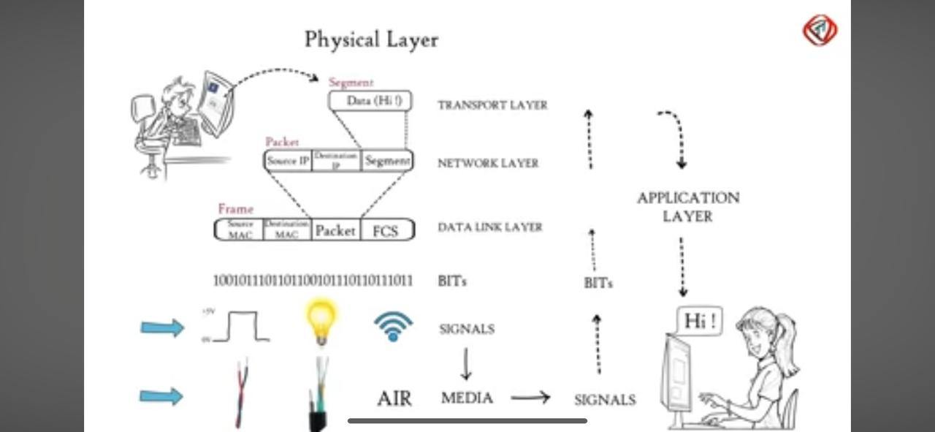
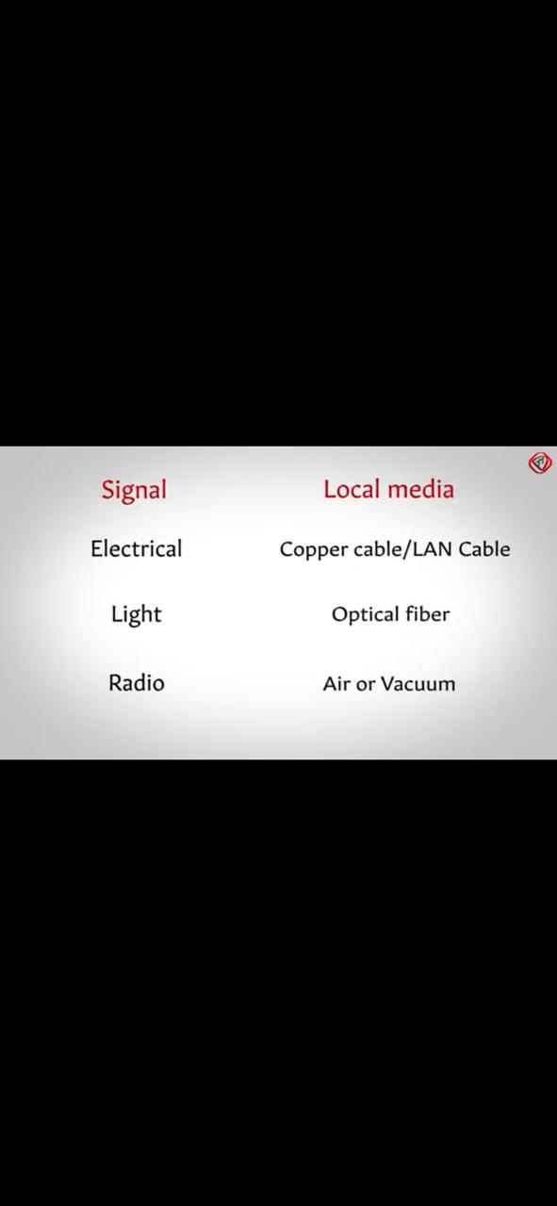
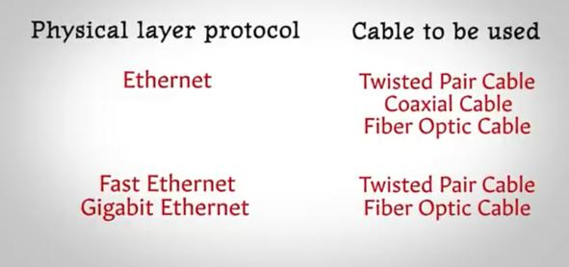

Slide 25
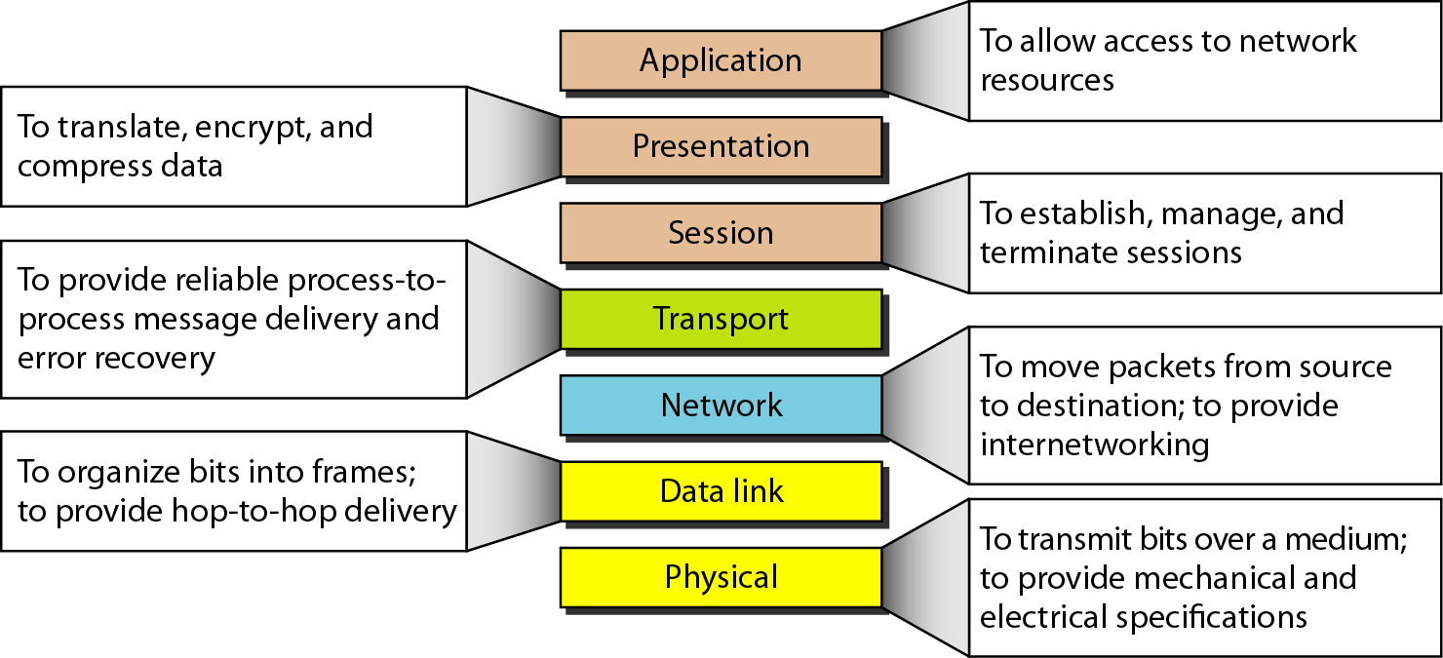
OSI Model: Layers Summary

Slide 26
TCP/IP Protocol Suite: Layered Architecture
Transmission Control Protocol / Internet Protocol (TCP/IP)
  Protocol suite used in the Internet today
  Hierarchical protocol made up of interactive modules, each of which provides a specific functionality
    Each upper-level protocol is supported by the services provided by one or more lower-level protocols
The original TCP/IP protocol suite was defined as four software layers built upon the hardware
  Host-to-network, internet, transport, and application
Today, TCP/IP is thought of as a five-layer model

Slide 27
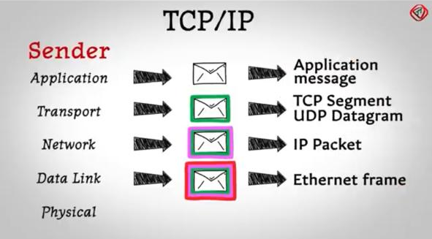
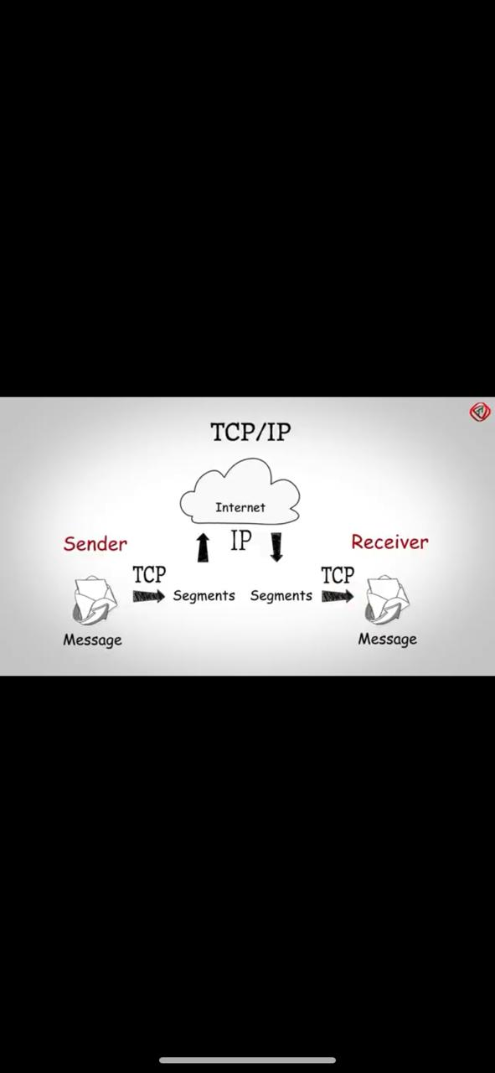

Slide 28
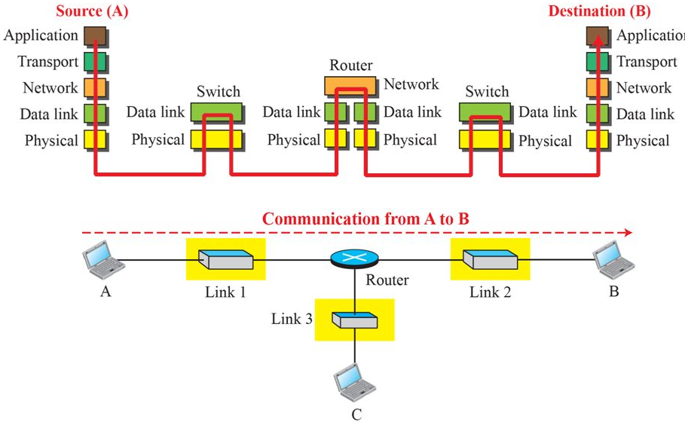
Communication through an Internet

Slide 29
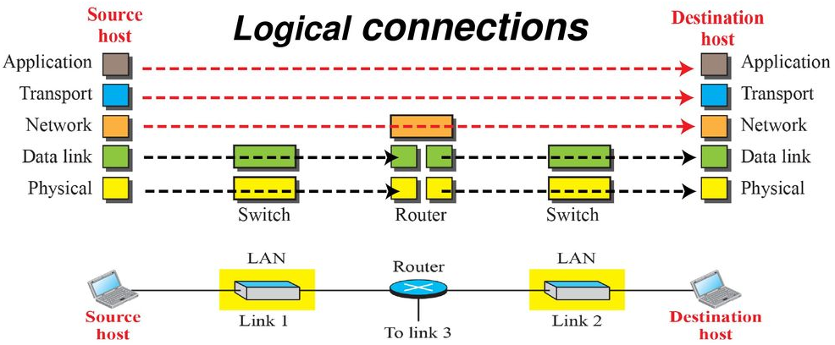
TCP/IP Protocol Suite: Layers in the TCP/IP Protocol Suite
Logical connections between layers of the TCP/IP protocol suite

Slide 30
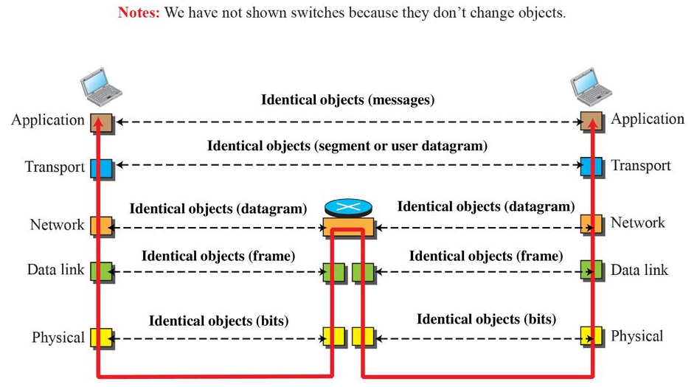
Identical objects in the TCP/IP Protocol Suite

Slide 31
TCP/IP Protocol Suite: Description of each Layer
Physical Layer
  Responsible for carrying individual bits in a frame across the link
  At the Physical Layer, communication is logical communication as
    There is another hidden layer, the transmission medium, which transmits signals
    Bits received in a frame from the data-link layer are transformed and sent through the transmission media
    Several protocols transform bits into a signal

Slide 32
TCP/IP Protocol Suite: Description of each Layer
Data-link Layer
  The Internet is made up of several links (LANs and WANs) connected by routers
  Overlapping sets of links between host and destination
  Routers choose the best links
    Data-link layer takes the datagram and moves it across the link using various protocols for the specific type of link
  Takes a datagram and encapsulates it in a packet called a frame
  Link layer provides complete error detection and correction, or only error correction

Slide 33
TCP/IP Protocol Suite: Description of each Layer
Network Layer
  Responsible for creating a connection between the source computer and the destination computer
  Communication is host-to-host
  Separate network layer to have a modular implementation
  Internet Protocol
    Routing
    defines the format of datagram, the structure of addresses, and routes packets from source to destination
    Connectionless protocol
    No flow control, error control, and congestion control

Slide 34
TCP/IP Protocol Suite: Description of each Layer
Network Layer
  Includes unicast and multicast routing protocols
  Creates forwarding tables for routers to help them in the routing process
  Other protocols that help IP in delivery
    Internet Control Message Protocol (ICMP) helps IP to report some problems when routing a packet
    Internet Group Management Protocol (IGMP) helps IP in multicasting
    Dynamic Host Configuration Protocol (DHCP) helps IP to get network-layer address for a host
    Address Resolution Protocol (ARP) helps IP to find the link layer address of a host or router when its network layer address is given

Slide 35
TCP/IP Protocol Suite: Description of each Layer
Transport Layer (I/II)
  Gets a message from the application program and delivers it to the corresponding application program on the destination host
  Independent of the application layer
  Transmission Control Protocol (TCP)
    Connection-oriented protocol
    Establishes a logical connection between transport layers at two hosts before transferring data
    Creates a logical pipe between two TCPs for transferring a stream of bytes
    Provides Flow control, error control, and congestion control

Slide 36
TCP/IP Protocol Suite: Description of each Layer
Transport Layer (II/II)
  User Datagram Protocol (UDP)
    Connectionless protocol
    Transmits user datagrams without creating a logical connection
    Each datagram is an independent entity
    Does not provide flow, error, or congestion control
    Small overhead and hence applicable for sending short messages
  Stream Control Transmission Protocol (SCTP)
    Designed to respond to new applications emerging in multimedia

Slide 37
TCP/IP Protocol Suite: Description of each Layer
Application Layer
  Communication between two processes
  Process sends a request to another process and receives a response
  Duty – Process-to-process communication
  Hypertext Transfer Protocol (HTTP)
    Vehicle for accessing the World Wide Web
  Simple Mail Transfer Protocol (SMTP)
    Used in e-mail service
  File Transfer Protocol (FTP)
    Used for transferring files from one host to another

Slide 38
TCP/IP Protocol Suite: Description of each Layer
Application Layer
  Terminal Network (TELNET) and Secure Shell (SSH)
    Used for accessing a site remotely
  Simple Network Management Protocol (SNMP)
    Administrator uses to manage the Internet at global and local levels
  Domain Name System (DNS)
    Used by other protocols to find the network-layer address of a computer
  Internet Group Management Protocol
    Collects membership in a group

Slide 39
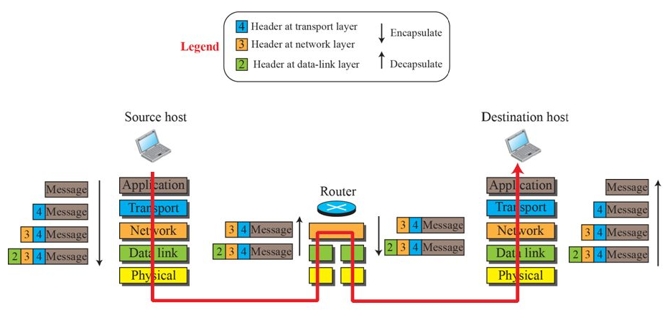
TCP/IP Protocol Suite: Encapsulation and Decapsulation
Encapsulation / Decapsulation

Slide 40
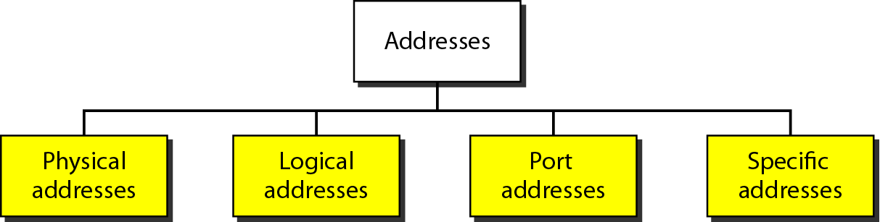
TCP/IP Protocol Suite: Addressing

Slide 41
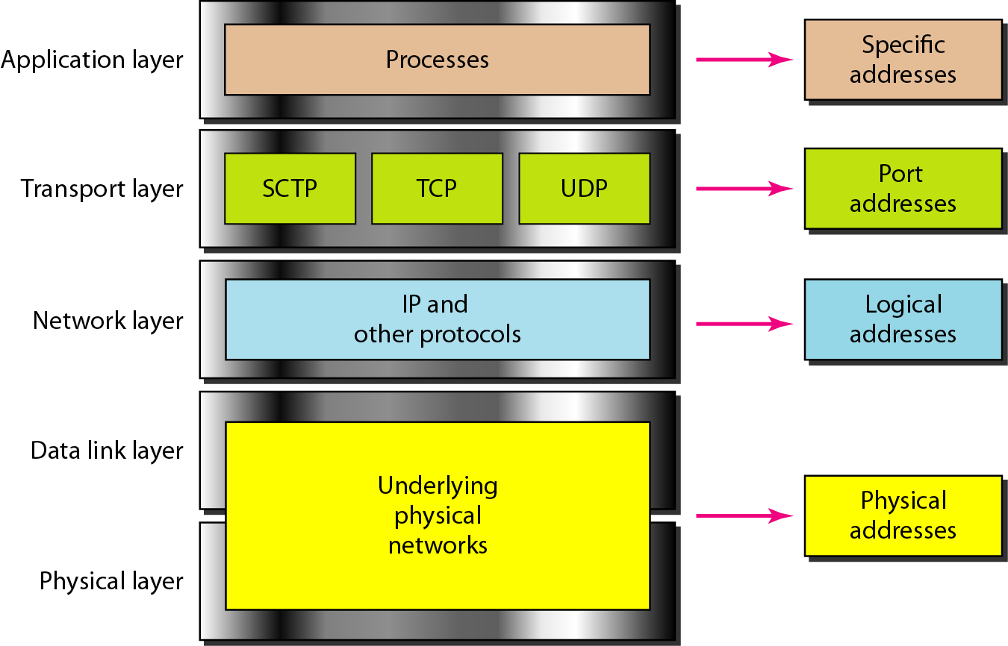
Relationship of layers and addresses in TCP/IP

Slide 42
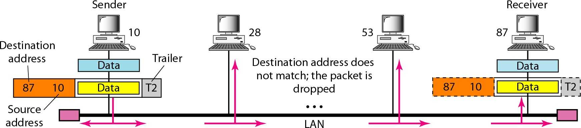
Physical Address
Called as link address also
Defined by LAN/WAN
Size and Format depends upon network
E.g: Ethernet uses 6-byte(48-bit) address imprinted on NIC

Slide 43
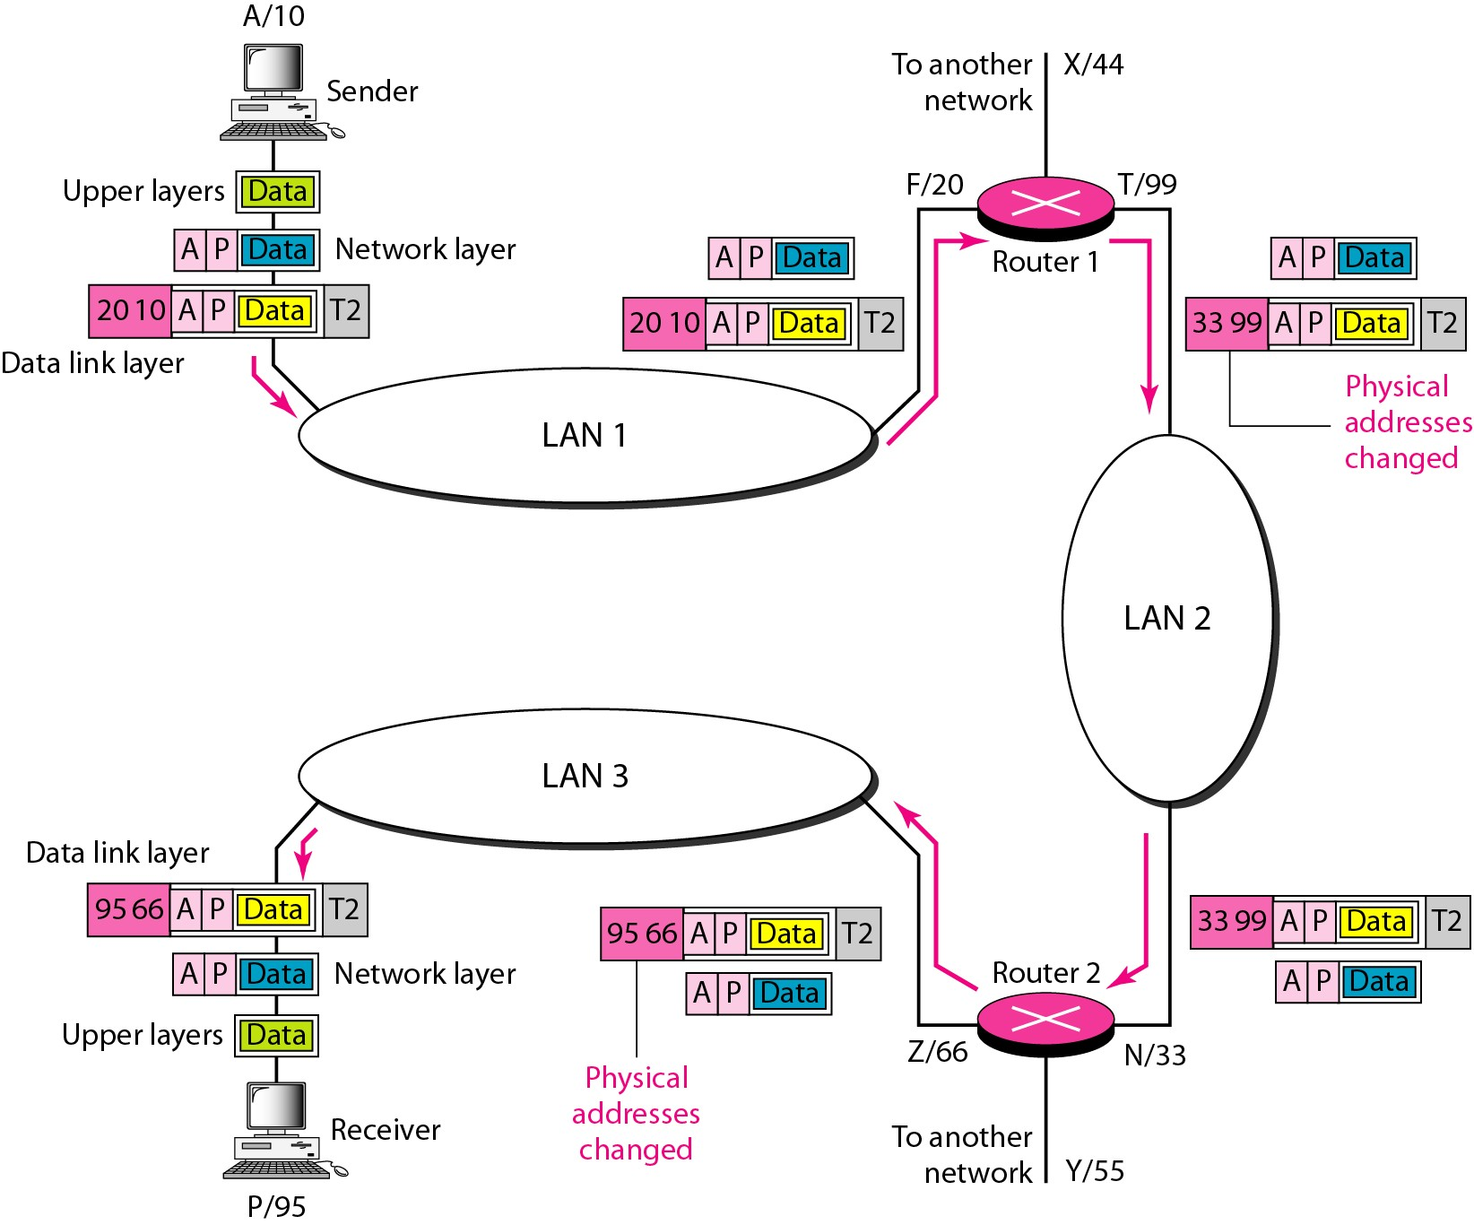
Logical Address
Necessary for Universal Communication
32-bit address uniquely define a host
Called as IP address also

Slide 44
Port Address
Specific Address
Used for process-to-process communication
Eg. Computer A → B via TELNET
A → C via FTP
In TCP/IP port address is of 16 bits in length
URL
E-mail Address

Slide 45
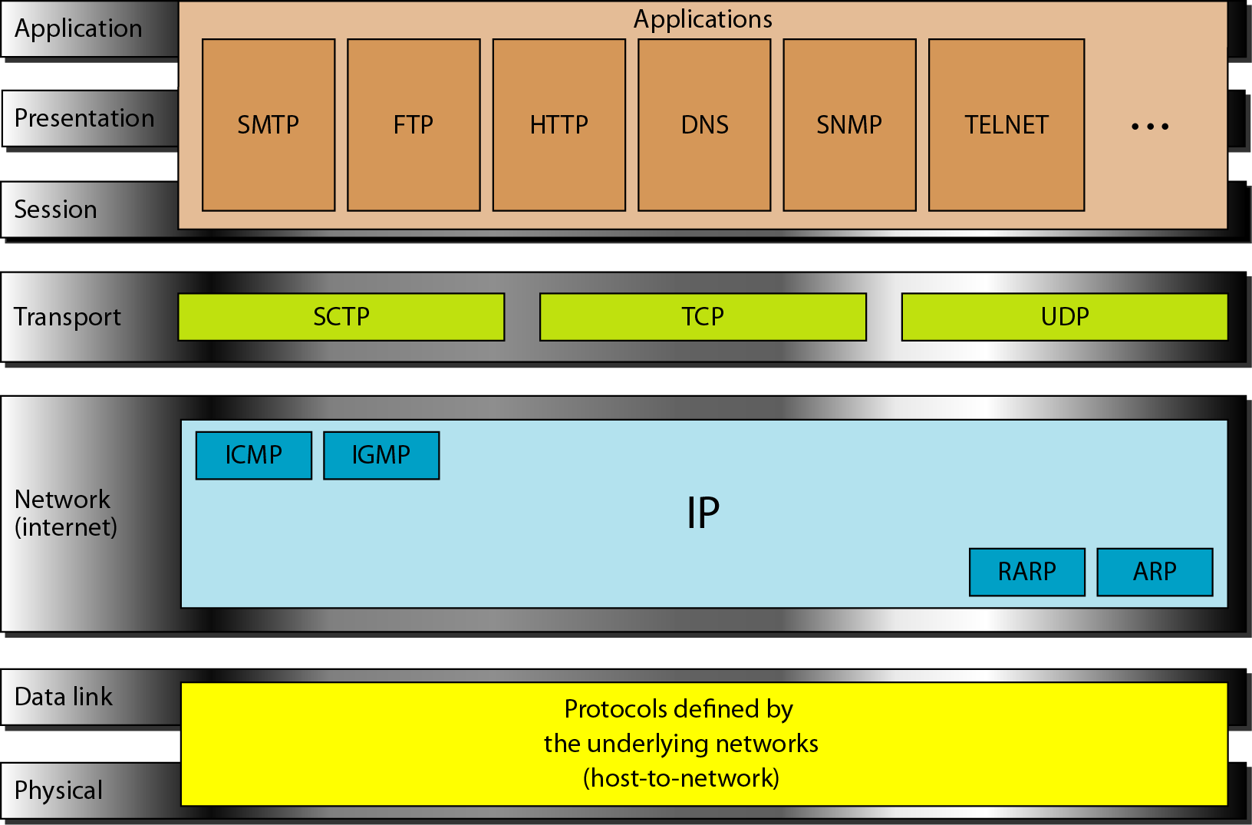
TCP/IP and OSI

